Slide 1
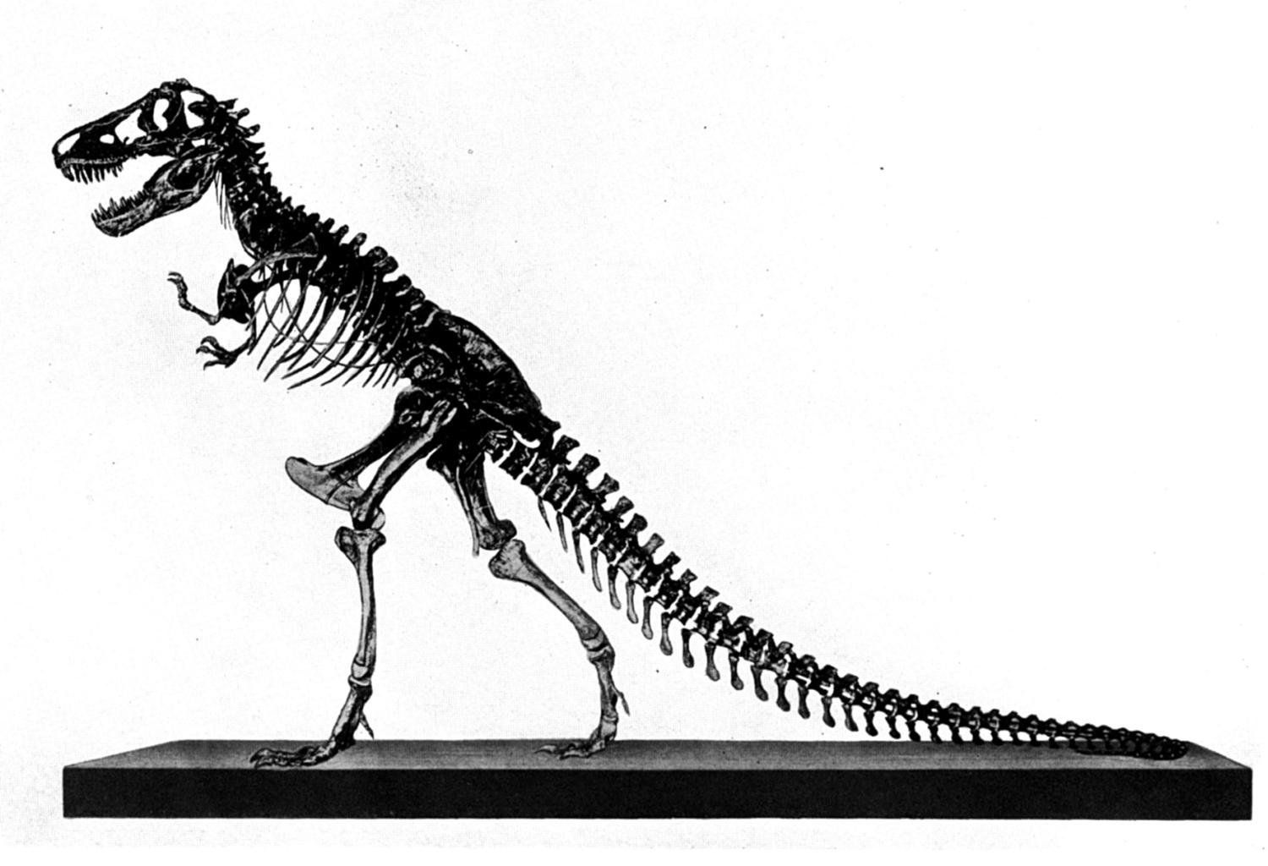
Behemoth &
Leviathan
Job 41:1-34
Part 3b

Slide 2
Review:
1 evidence for dinosaurs and man living together
2_{(a-d)} the conflict between Job, friends, Jehovah; Elihu’s response; God’s 1st response
3_{a} God’s 2nd response –the BEHEMOTH
3_{b} God’s 2nd response –the LEVIATHAN
concept
context
content
This Lesson

Slide 3
These Animals
(Job 40:6-41:34)
Leviathan and Behemoth are as literal as the animals mentioned in 38:39-39:30!
Behemoth cannot be an elephant or hippopotamus
Leviathan cannot be a crocodile

Slide 4
MANY CHRISTIANS HAVE BEEN
“EVOLUTIONIZED” BY THE MEDIA AND EDUCATION
Take secular thinking to the bible rather than build their way of thinking from the bible
Take worldly opinions to the bible rather than take the wisdom in the bible to the world

Slide 5
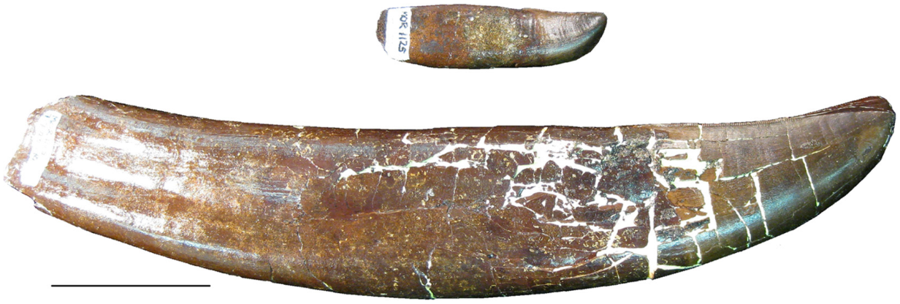
“TEST YOURSELVES”
Have I been “evolutionized?”
The Tyrannosaurus Rex had
very large teeth
What was the original diet of
Tyrannosaurs like?
Wikipedia Commons
5 cm

Slide 6
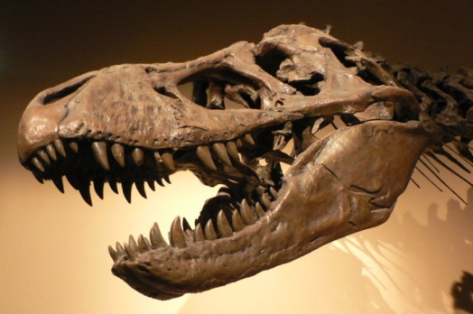
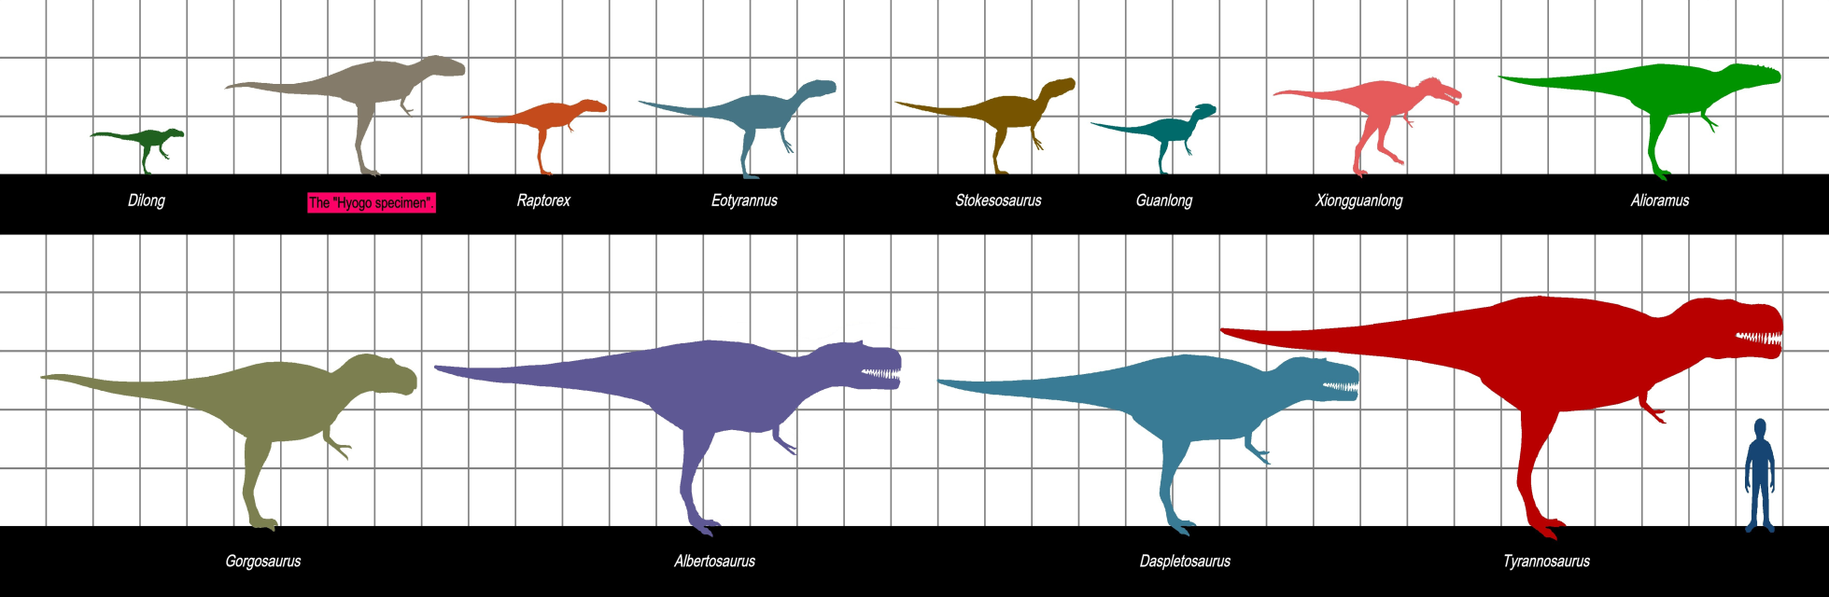
“TEST YOURSELVES”
Have I been “evolutionized?”
What was the original diet of
Tyrannosaurs like?
  Herbivore?
  Carnivore?
  Omnivore?
Creation Wiki Commons
Genesis 1:29, 30, “And God said, ‘See, I have given you every herb that yields seed which is on the face of all the earth, and every tree whose fruit yields seed; to you it shall be for food. Also, to every beast of the earth, to every bird of the air, and to everything that creeps on the earth, in which there is life, I have given every green herb for food’; and it was so.”
Creation Wiki Commons

Slide 7
“Big Teeth”
The need for critical thinking exists!
Without observation…only educated guesses exist
God created fixed “kinds” in Genesis 1:24, 25
  Kinds produce according to kind (Gen. 1: 11, 12)
  The gene pool contained great information for tremendous variation within kinds (example: polar bears, brown bears, black bears and pandas from the same kind!)
  Not evolution, but a loss of information to bring about variation within the kind

Slide 8
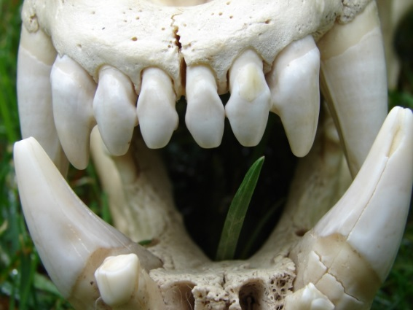
“Big Teeth”
Picture from: www.grizzlybay.org
Without observation…only educated guesses
God created fixed “kinds” in Genesis 1:24, 25
  Polar bears and Brown bears are from the same “kind”
  Polar bears are highly carnivorous; Brown bears are not
    “Despite their reputation, most brown bears are not highly carnivorous, as they derive up to 90% of their dietary food energy from vegetable matter.^{[61]} They often feed on a variety of plant life, including berries, grasses, flowers… as well as fungi such as mushrooms.^{[3]”} (http://en.wikipedia.org/wiki/Brown_bear#Dietary_habits)

Slide 9
“Big Teeth”
Without observation…only educated guesses
God created fixed “kinds” in Genesis 1:24, 25
The fossil remains of T. Rex are likely from the flood, almost 2000 years after the original “kind”
  To assume T. Rex was the original created kind would be like assuming the Great Dane was the original created kind from which all dogs sprang…or…
  That polar bear skulls depict the original bear skull
    P.B. skulls cannot handle the stress of a hard diet
    P.B. “lost” the grinding molars that brown bears have (http://news.discovery.com/animals/polar-bear-skulls-cant-take-the-stress.htm)

Slide 10
Therefore
The past is not understood by the present
  The key to the present is found in understanding the past (e.g., 2 Pet. 2:4-9; 3:4-7; etc.)
  We understand the past by revelation
The Bible gives us real history from which we can know:
  Who we are
  Why we are here
  Where we are from
  Where we are going

Slide 11
Leviathan (Job 41:1-34)
a crocodile or a dinosaur?
5 REASONS FOR REJECTING A CROCODILE!

Slide 12
Reason 1
“Behold, your expectation is false; will you be laid low [cast down, KJV; overwhelmed, NKJV] even at the sight of him?” (Job 41:9, NASB)
  do crocodiles have that effect on men?
    why crocodile hunters and wrestlers?
    does the very sight of a crocodile cast us down low?

Slide 13
Reason 2
“When he raises himself up the mighty are afraid; because of his crashings they are beside themselves” (Job 41:25)
  how high does a crocodile rise?
  do mighty men get “beside themselves” by a crocodile’s “crashings”?
  does a crocodile even make “crashings”?

Slide 14
Reason 3
“His undersides are like sharp potsherds; He spreads pointed marks in the mire” (Job 41:30)
  pointed bellies on crocodiles?
  how would a crocodile leave pointed marks in the mire?
BEING DRUG UPSIDE DOWN!

Slide 15
Reason 4
“He makes the deep boil like a pot; He makes the sea like a pot of ointment. He leaves a shining wake behind him; one would think the deep had white hair” (Job 41:31, 32)
  have you ever seen a crocodile make the ocean look like it is boiling?
  does he leave behind a white wake?

Slide 16
Reason 5
“Out of his mouth go burning lights; sparks of fire shoot out. Smoke goes out of his nostrils, as from a boiling pot and burning rushes. His breath kindles coals and a flame goes out of his mouth” (Job 41:19-21)
  have you ever seen a crocodile breathe fire?

Slide 17
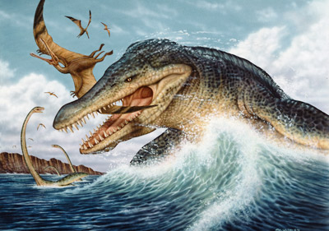
Leviathan: A Sea Living Monster
his outer coat: impenetrable
41:13, 15-17, 26-30
his size: gracefully, yet fearfully large
41:9, 12, 25
his teeth: terrible
41:14
his neck: strong
41:22
his breath: fire
41:19-21

Slide 18
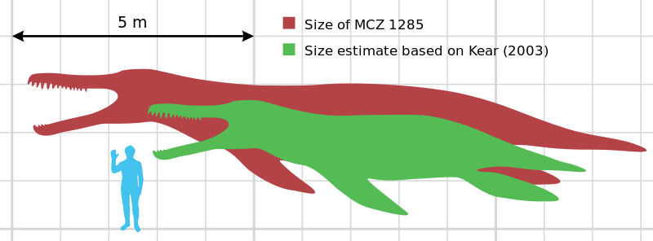
LEVIATHAN:
King Of Pride
“On earth there is nothing like him, which is made without fear. He beholds every high thing; he is king over all the children of pride”
(Job 41:33, 34)

Slide 19
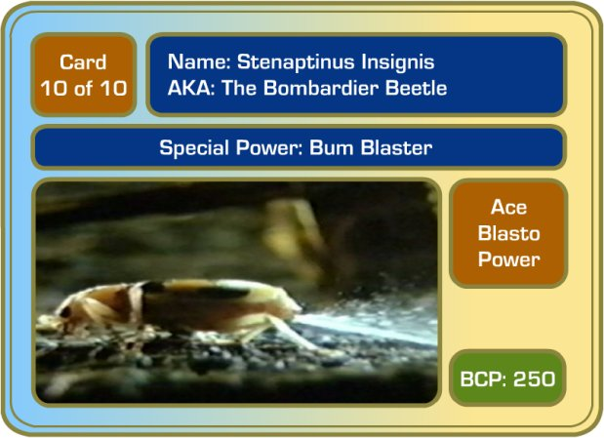
Dinosaurs & Beetles
what do half inch beetles and fire breathing dragons have in common?
perhaps an explanation of how Leviathan blew fire
In speaking about the Bombardier beetle’s 212º noxious gas blast, Duane T. Gish, Ph.D. writes:
  “The chemicals and catalysts react to form another chemical, called quinone, which is very irritating. All of this happens extremely quickly in the bombardier beetle’s combustion tubes. . .”

Slide 20

Bombardier
“. . .Scientists using special high-speed cameras have recorded both audible pops and puffs of smoke when the bombardier beetle sprays. They have also discovered that some species emit sprays in violent pulses at the rate of 500 per second” (Dinosaurs By Design, p. 83).
IMAGINE A LARGE REPTILE WITH THE SAME MECHANISM?

Slide 21
IMAGINE
the evolution of a bombardier beetle?
  one mistake in the intricate design and he would be literally, up in smoke!
POOF!

Slide 22
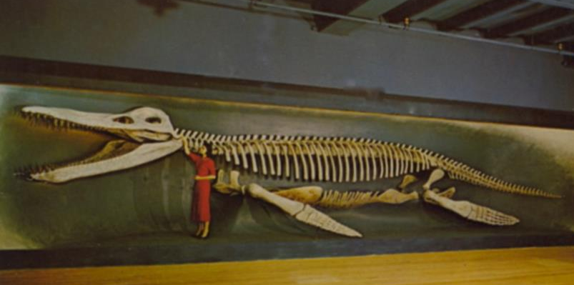
Do You Know Why The Bible Talks About Dinosaurs?
(1)
“For in six days the LORD made the heavens and the earth, the sea, and all that is in them, and rested the seventh day. Therefore the LORD blessed the Sabbath day and hallowed it” (Ex. 20:11)

Slide 23
Do You Know Why The Bible Talks About Dinosaurs?
(2)
24 O LORD, how manifold are Your works! In wisdom You have made them all. The earth is full of Your possessions—
25 This great and wide sea, In which are innumerable teeming things, Living things both small and great.
26 There the ships sail about; There is that Leviathan Which You have made to play there.
(Ps. 104)

Slide 24
Do You Know Why The Bible Talks About Dinosaurs?
(3)
To rebuke man’s pride (Job 40-42)

Slide 25
Job 42
¹ Then Job answered the LORD and said:
² "I know that You can do everything, And that no purpose of Yours can be withheld from You.
³ You asked, ‘Who is this who hides counsel without knowledge?’ Therefore I have uttered what I did not understand, Things too wonderful for me, which I did not know.
⁴ Listen, please, and let me speak; You said, ‘I will question you, and you shall answer Me.’
⁵ "I have heard of You by the hearing of the ear, But now my eye sees You.
⁶ Therefore I abhor myself, And repent in dust and ashes."

Slide 26
Behemoth & Leviathan
Displayed the awesome power of God
Displayed the weakness of man
  If Job could not approach Leviathan, why contend against Jehovah (41:8-11)?
Displayed the fearful terror of Jehovah
  2 Corinthians 5:11; Hebrews 10:31
  A mythological interpretation destroys the entire context and the point!

